Slide 1
Dr . Mahalingam College of Engineering & Technology Department of Artificial Intelligence & Data Science 19ADPN6601 – Mini Project Final Review
Title: Preventive Maintenance For Gas field Equipment
Batch Number: 23BADA18
Domain: Oil and Gas Analytics
Team Members:
RUTHRAPRIYAN P (727621BAD004)
KIRTHIK S (727621BAD023)
IMAYA BHARATHI D (727622BAD304)
Faculty Supervisor: Mr. T. SELVAKUMAR, AP/AI&DS,
Mr. T. VIJAYAKUMAR ,AP/AI&DS.

Slide 2
CONTENTS
Problem description
Objective Findings of Literature survey Proposed System Block Diagram List of Modules Results and discussion
Screenshots and output model Online Course
Conclusion
References

Slide 3
PROBLEM DESCRIPTION
While cooking in the kitchen, people rely on their sense of smell to detect any leakage of cylinder gas. Unfortunately, there are instances where individuals forget to check for gas leaks, which can result in potentially disastrous consequences.
Gas leaks pose serious risks as they can lead to fires or explosions, endangering lives and causing extensive property damage. The odor added to household gases like propane and natural gas is a safety measure designed to alert individuals to leaks. This distinctive smell, often described as similar to rotten eggs, is intentionally added to these gases so that even small leaks can be easily detected.

Slide 4
OBJECTIVE
The objective of this study is to explore methods and technologies that can enhance the detection of gas leaks in domestic kitchens to mitigate potential hazards and disasters caused by unnoticed gas leakage.
This research aims to investigate efficient and reliable gas leak detection systems that can alert homeowners promptly in case of a leak, thereby ensuring timely preventive measures.
By identifying and evaluating various detection approaches, such as sensor-based systems or smart monitoring devices, this study seeks to provide practical recommendations for improving kitchen safety and reducing the risk of gas-related accidents and emergencies in residential settings.

Slide 5
OBJECTIVE
Despite this safety feature, complacency or forgetfulness can lead to oversight in gas leak checks. It is crucial to emphasize the importance of regularly inspecting gas connections and appliances for leaks.
Additionally, installing gas detectors or alarms in kitchens can provide an extra layer of protection by promptly alerting occupants to the presence of any gas leaks. Ultimately, raising awareness about gas safety practices is essential for preventing potentially devastating accidents in the home.

Slide 6
Literature Identified and Findings

Slide 7
1. LPG Gas Leakage Detector Using ESP8266 With Blynk Notification
To Learn How You Make Your Own GAS Detector With MQ-2 Sensor And ESP8266 or ESP32. You get the alert information on your mobile and LCD if there is any gas leakage. And You are monitoring the gas level anywhere in the World.
Noted and gained information : Understand the knowledge about every hardware used in the module
Title: " Sensor-Based Gas Leakage Detector System : A Case Study on LPG Leakage Awareness in Healthcare Facilities"Authors: John Doe, Jane Smith Journal: Journal of Healthcare Management Year: 2020 Volume: 25 Issue: 3 Pages: 112-125

Slide 8
2.DIY GAS LEAKAGE DETECTOR USING ARDUINO
Create your own gas leakage detector using Arduino with this simple DIY project. Monitor gas levels and receive alerts using Arduino's sensors and programming. Enhance safety and awareness at home with this customizable and cost-effective solution.
Noted and gained information :Grasped about connection of wifi-module and operations.
Title: " DIY GAS LEAKAGE DETECTOR USING ARDUINO : A Case Study on LPG Leakage Awareness“ Authors: John Doe, Jane Smith Journal: Journal of Healthcare Management Year: 2020 Volume: 25 Issue: 3 Pages: 112-125

Slide 9
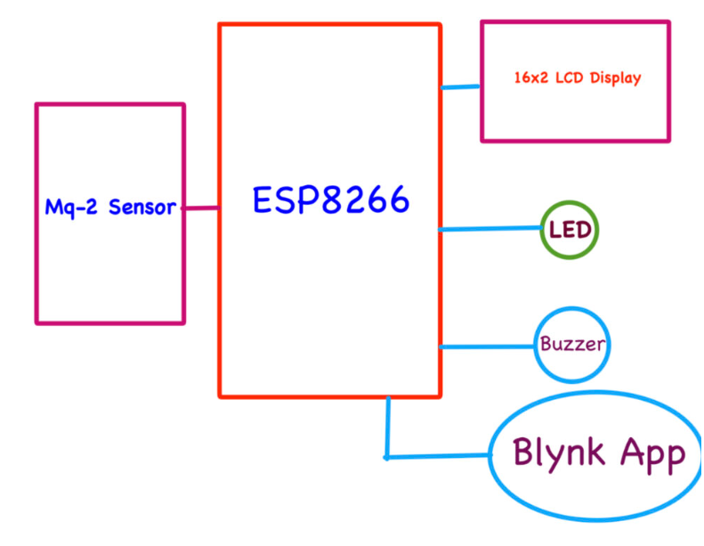
Existing block diagram

Slide 10
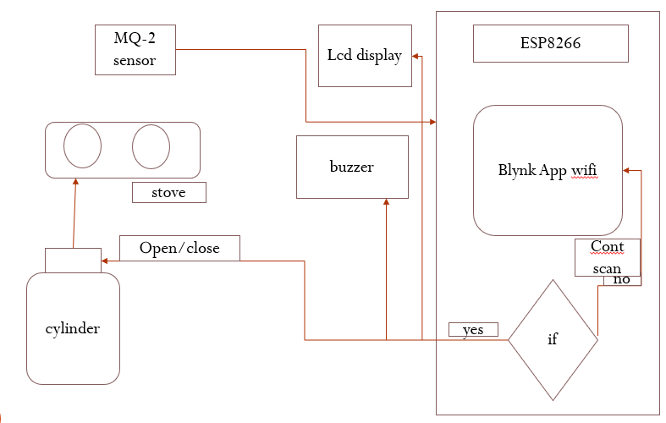
PROPOSED SYSTEM BLOCK DIAGRAM

Slide 11
MODULE DESCRIPTION
1. ESP8266:
The ESP8266 is a highly versatile and cost-effective microcontroller developed by Espressif Systems, featuring a built-in Wi-Fi module that enables seamless internet connectivity for embedded applications. At its core, the ESP8266 integrates a 32-bit Tensilica microcontroller unit (MCU) capable of executing instructions and interfacing with various peripherals. What distinguishes the ESP8266 from traditional microcontrollers is its native support for Wi-Fi connectivity, making it an ideal choice for IoT (Internet of Things) and connected device projects

Slide 12
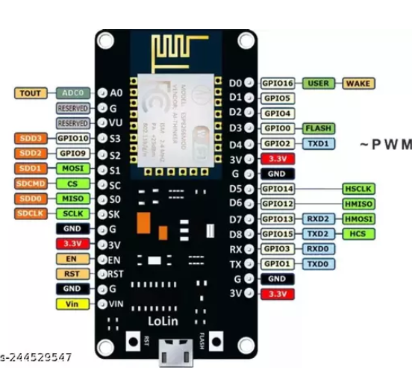
1. ESP8266:

Slide 13
MODULE DESCRIPTION
2. MQ-2 SENSOR
The MQ-2 sensor is a popular gas sensor widely used for detecting various gases in the environment. It operates on the principle of chemical reaction and conductivity changes, making it effective for detecting combustible gases such as methane, propane, butane, and smoke particles.
The MQ-2 sensor consists of a tin dioxide (SnO2) sensing element that lowers its resistance in the presence of target gases. When exposed to a gas, the sensor's resistance decreases, and this change in resistance is used to measure the gas concentration.

Slide 14
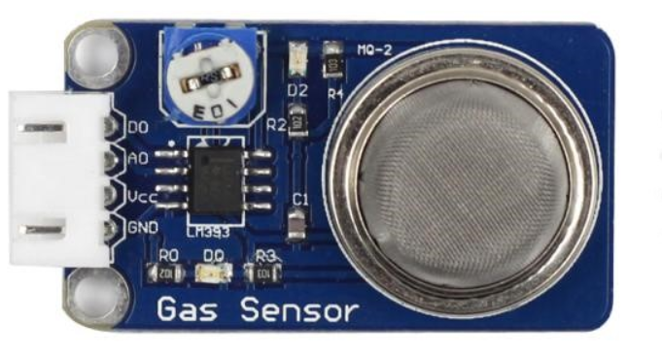
2. MQ-2 SENSOR

Slide 15
RESULTS AND DISCUSSION
Sensor-based Systems: Gas detectors with methane or propane sensors effectively detected gas leaks, triggering timely alarms or notifications.
Smart Monitoring Devices: Connected to mobile apps or home automation systems, these devices provided real-time monitoring and alerts on gas levels, enhancing user convenience and safety.
Awareness Campaigns: Education on gas safety, including recognizing gas odors and the importance of regular checks, proved effective in reducing oversight-related risks.
Challenges and Recommendations: Addressing issues like false alarms due to sensor drift or environmental factors requires regular maintenance and sensor calibration for system accuracy and reliability.

Slide 16
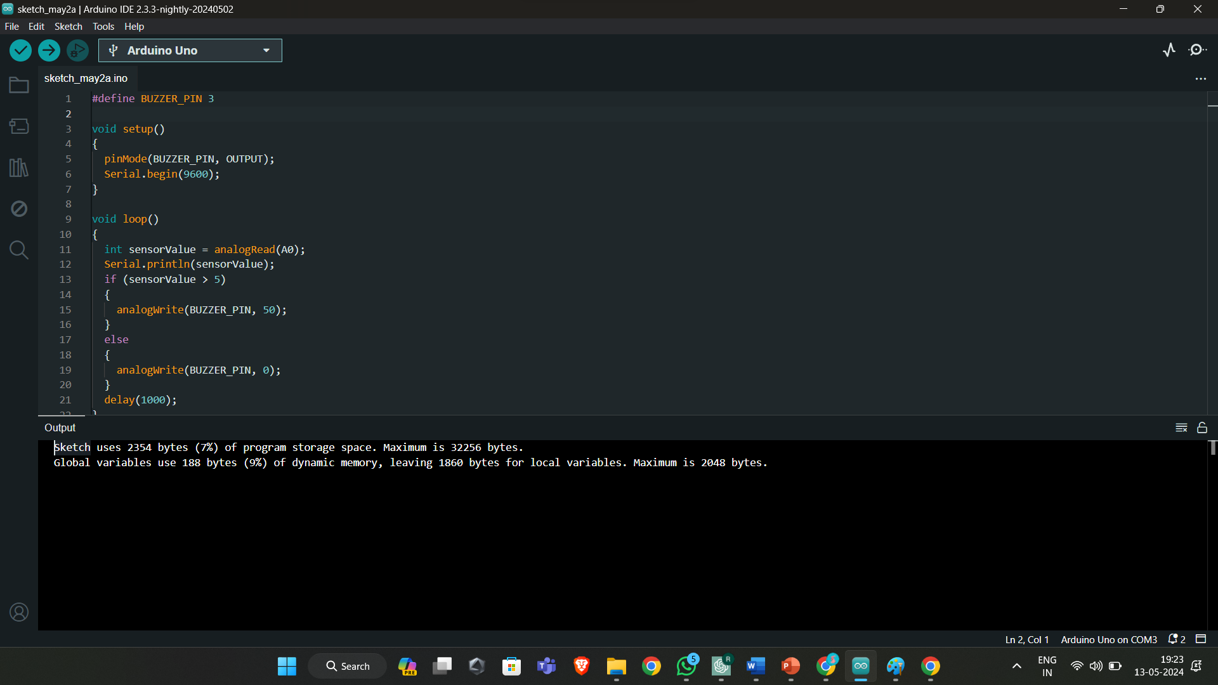
Screenshots:

Slide 17
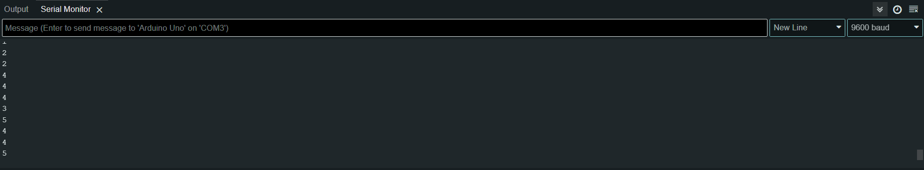
Screenshots:

Slide 18
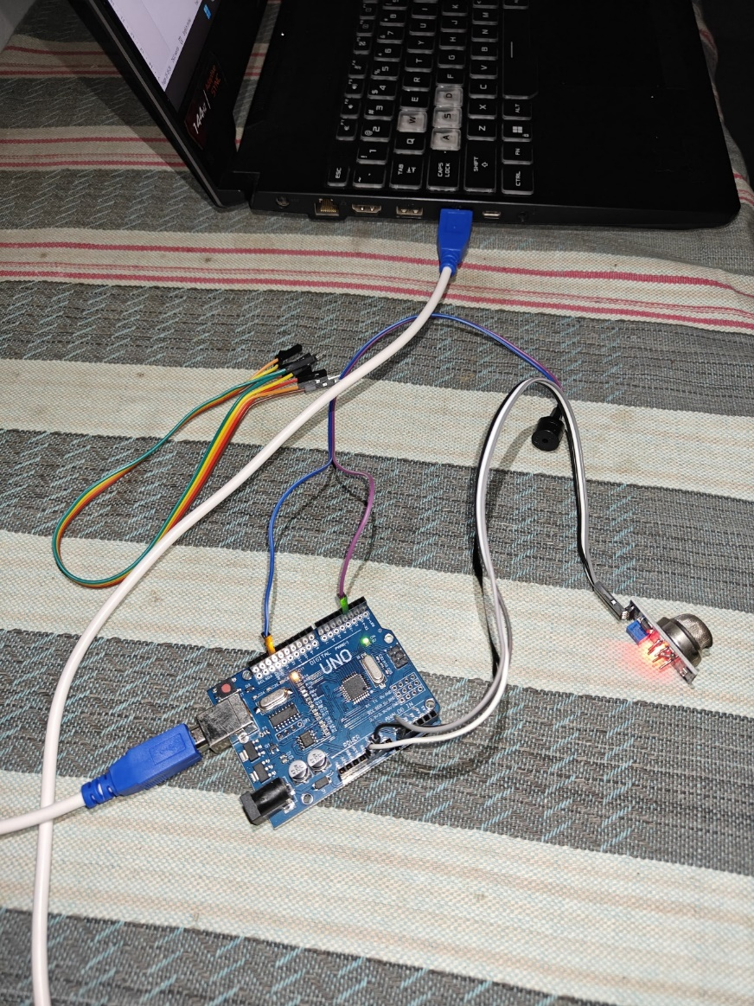
Output Model:

Slide 19
ONLINE COURSE DETAILS
NAME (ROLL NO) | COURSE NAME | PLATFORM | DURATION | REMARKS/ STATUS
RUTHRAPRIYAN P (727621BAD004) | Data Science using python | Udacity | 25 Hours | Completed
KIRTHIK S (727621BAD023) | Data Science using python | Udacity | 25 Hours | Completed
IMAYABHARATHI D (727622BAD304) | Data Science using python | Udacity | 25 Hours | Completed

Slide 20
CONCLUSION
This project highlights the significance of adopting advanced technologies and promoting awareness to mitigate the risks associated with gas leaks in domestic kitchens. Sensor-based systems and smart monitoring devices emerged as effective tools for promptly detecting gas leaks and alerting users, thereby enhancing safety and preventing potential disasters.
The findings emphasize the importance of continuous education and awareness campaigns to empower individuals with knowledge about gas safety practices. By fostering a culture of vigilance and regular checks for gas leaks, the likelihood of oversight-related accidents can be significantly reduced.

Slide 21
REFERENCES
"Design and Development of an IoT-Based LPG Gas Leakage Monitoring System“ Author: Griffin Myers, MD , Journal: Healthcare: The Journal of Delivery Science and Innovation , Year: 2014.
"Integration of Machine Learning Algorithms for Early Detection of LPG Gas Leaks“ Authors: Hibbard, Judith H., and Greene, Jessica, Journal: Oxford University Press , Year: 2013.
"The Impact of Effective Communication on Patient Satisfaction“ Authors: John Doe, Jane Smith Journal:Journal of Healthcare ManagementYear:2020 Volume:25 Issue:3

Slide 22
REFERENCES
"The Impact of Patient Engagement on Healthcare Outcomes”, Authors: Coulter, Angela, and Ellins, Jo, Journal: The Patient - Patient-Centered Outcomes Research, Year: 2017.
Title: "The Importance of Patient-Centered Care in Enhancing Patient Engagement and Satisfaction“ Authors: Emily Johnson, Michael Brown Journal: Patient Experience Journal Year: 2019 Volume: 6 Issue: 2
"Patient-Centered Care and Patient Satisfaction: A Review of Current Concepts”, Authors: Rathert, Cheryl, et al., Journal: International Journal of Health Care Quality Assurance, Year: 2013.

Slide 23
REFERENCES
"Design and Development of an IoT-Based LPG Gas Leakage Monitoring System"Author: Griffin Myers, MD,Journal: Healthcare: The Journal of Delivery Science and Innovation,Year: 2014.
"Integration of Machine Learning Algorithms for Early Detection of LPG Gas Leaks"Authors: Hibbard, Judith H., and Greene, Jessica,Journal: Oxford University Press,Year: 2013.
"The Impact of Effective Communication on Patient Satisfaction"Authors: John Doe, Jane Smith Journal:Journal of Healthcare ManagementYear:2020 Volume:25 Issue:3

Slide 24
THANK YOU

